Slide 1
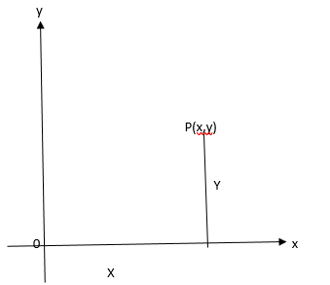
Geometry
A point can be located in the co-ordinate axes system but a point does not have any dimension
It has – no length
-- no width
-- no thickness

Slide 2
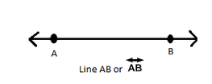

Geometry
Line : A line is a set of infinite points
A line has no end points
It cannot be ‘measured’
It is represented by $\overset{⃡}{AB}$

Slide 3
Geometry
Line Segment:
A line segment has 2 end points
It can be ‘measured’
It is denoted by AB ________________________
A 28.7 cm B

Slide 4

Geometry
Ray:
A ray has only one end point
It also cannot be measured
It is denoted by $\vec{OP}$ O - ------------------------------> P

Slide 5
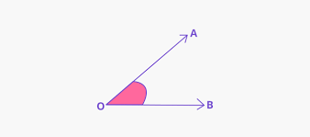
Geometry
Angle:
.
When two rays unite an angle is formed
. The point of union is called the ‘vertex’

Slide 6
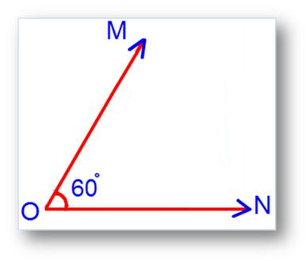
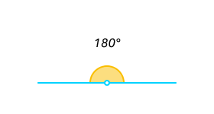
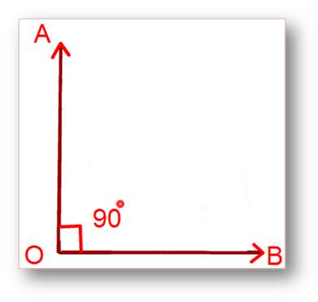
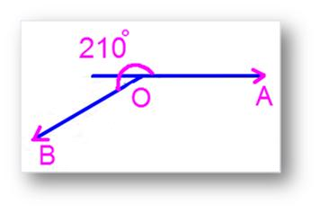
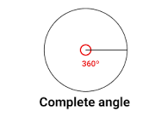
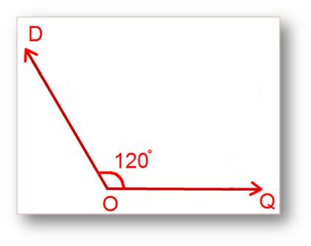
Geometry
Types of Angles :
Acute angle : Straight angle :
Acute angle :
Right angle : Reflex angle :
Obtuse Angle:

Slide 7
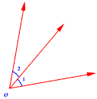
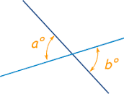
Types of angles Adjacent angles : Vertically opposite angles :

Slide 8

Geometry
If <a + <b = 90 then <a$\&$ <b are called Complementary angles
If <a + <b = 180 then <a & <b are called Supplementary angles
Angle Complement Supplement
0 90 180
30 60 150
45 45 135
60 30 120
90 0 90
X (90-x) (180 -x)

Slide 9
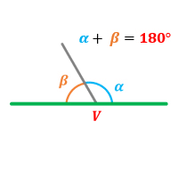
Geometry
If <a , <b are adjacent angles and <a + <b = 180,
then <a, <b are called a ’ linear pair’ of angles

Slide 10
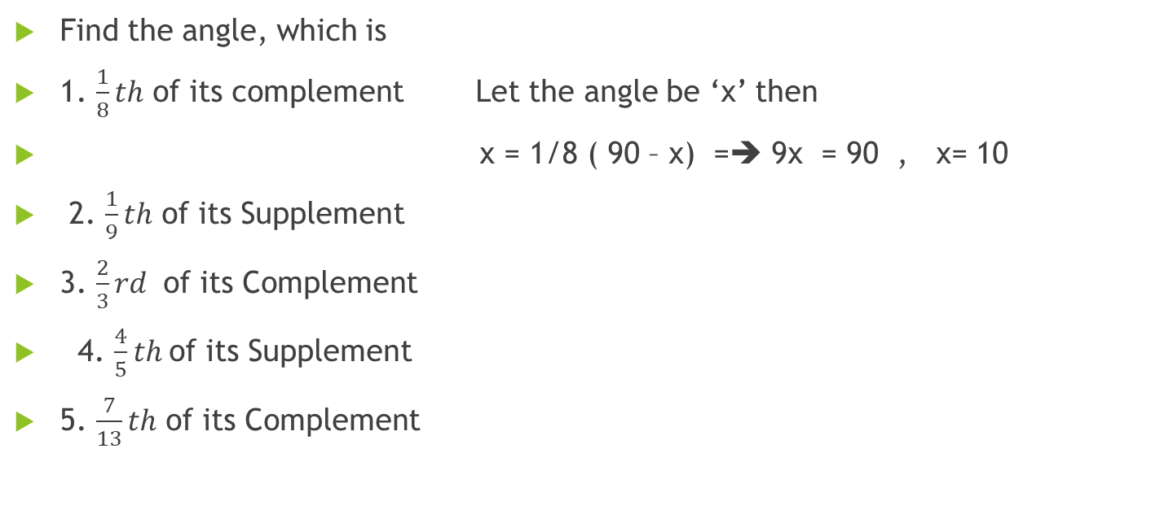
Geometry
Find the angle, which is
1. $\frac{1}{8}th$ of its complement Let the angle be ‘x’ then
x = 1/8 ( 90 – x) =➔ 9x = 90 , x= 10
2. $\frac{1}{9}th$ of its Supplement
3. $\frac{2}{3}rd$ of its Complement
4. $\frac{4}{5}th$of its Supplement
5. $\frac{7}{13}th$ of its Complement

Slide 12
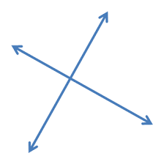
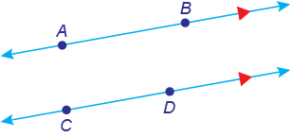
Geometry : Lines and Angles
Given two lines , either they intersect at one point
or they do not intersect
at any point

Slide 13
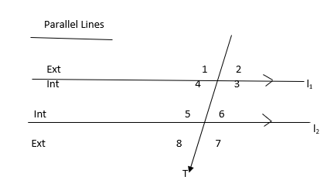
Geometry : Lines and Angles
‘t’ is the transversal
Interior Angles : 3, 4, 5, 6
Exterior Angles : 1, 2, 7, 8

Slide 14
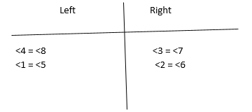
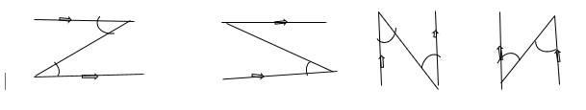
Geometry : Lines and Angles
Corresponding Angles :
One interior angle, one exterior angle but on the same side of the transversal
Alternate Angles:
Both interior angles, but on either side of the transversal.
Look for
<6 = <4 <5 = <3

Slide 15
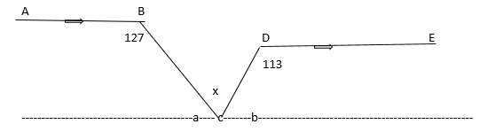
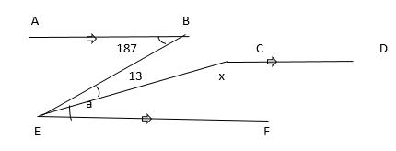
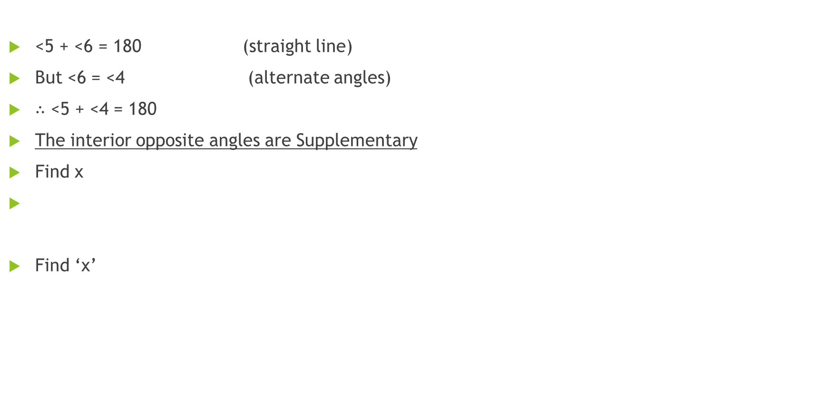
Geometry : Lines and angles
<5 + <6 = 180 (straight line)
But <6 = <4 (alternate angles)
∴ <5 + <4 = 180
The interior opposite angles are Supplementary
Find x
Find ‘x’

Slide 17

Geometry: Triangles
A
Definition: B C
An ‘area’ enclosed by three line segments is a triangle

Slide 18
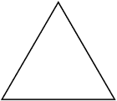
Triangles
Properties:
1. Sum of three angles of a triangle is 180

Slide 19
Triangles
2. The sum of any two sides of a triangle must be greater than the third sides
If AB + BC = AC then points A, B, and C are collinear points.
And for a triangle to happen point B should get up or down.
Then AB + BC > AC

Slide 20
triangles
3. The difference between any two sides of a triangle must be lesser than the third side

Slide 21

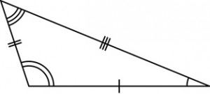
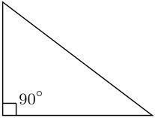

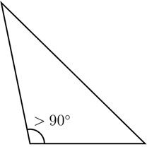
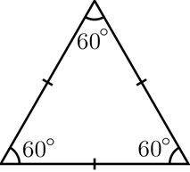
Triangles Scalene triangle
Acute angled triangle
Right angled triangle isosceles triangle
Obtuse angled triangle equilateral triangle

Slide 23
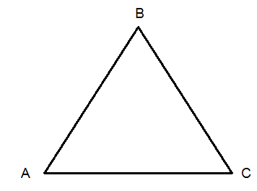
Triangles
4. The sides opposite to equal angles are equal in a triangle
If <A = <C then AB = BC
5. The angles opposite to equal sides are equal in a triangle
If AB = BC , then <A = <C

Slide 24
Triangles
6. In a triangle , the side opposite to the greater angle is greater in measure

Slide 25
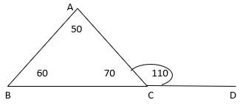

Geometry
7. In a triangle the exterior angle is equal to the sum of interior opposite angles
<ACD is the exterior angle of $∆ABC$
<ACD = <BAC + <ABC
110 = 50 + 60
The exterior angle of a triangle is equal to the sum of interior
Opposite angles

Slide 26
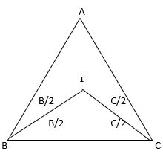

Geometry
8. BI, CI are the interior angle bisectios of <B, and <C
Express <BIC in terms of <A
BIC = 180 – $\left(\frac{B}{2}+\frac{C}{2}\right)$
= 180 –($90−\frac{A}{2})= 90+\frac{A}{2}$

Slide 27
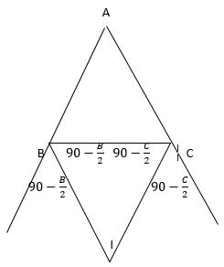

Triangles
9. )))
BI, CI are the exterior angle bisector of <B and <C
Express <BIC in terms of <A
From $∆BIC$<BIC = 180 – ($90−\frac{B}{2})−(90−c/2)$
<BIC = $\frac{B}{2}+ \frac{C}{2}=90− \frac{A}{2}$

Slide 28
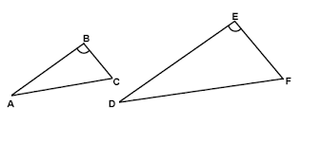
SIMILAR TRIANGLES
Similar Triangles :
Two triangles are said to be similar if
(i) their corresponding angles are equal and
(ii) their corresponding sides are proportional.
Equiangular Triangles are similar.

Slide 29
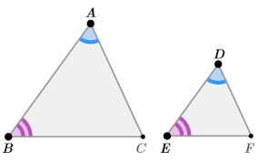
SIMILAR TRIANGLES
If two triangles ABC and DEF are similar then the ratio of their corresponding sides will be in proportion.
AB/DE = BC/EF = AC/DF

Slide 30


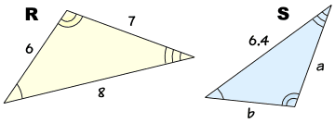
SIMILAR TRIANGLES
Given the following triangles are similar, find the length of s
Find ‘a’ and ‘b’
There are four types of similar triangle sums

Slide 31
Exercise
Type I :
A
6 D
x c 8
9 E
B

Slide 32
exercise
P S
12
10 R x
8
Q
T

Slide 33
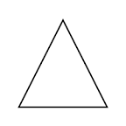





exercise
Type : II
$$7$$
$$8⋅4$$
$$>$$
11
$$x$$
$$>$$

Slide 34







exercise
$$3$$
$$4$$
$$>$$
$$9$$
$$12$$
$$>$$
$$x$$

Slide 35
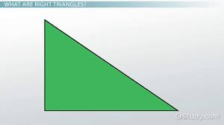




exercise
$$x$$
$$6$$
$$16$$
$$8$$

Slide 36
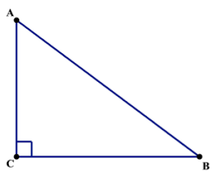







Exercise If AC = 6 and BC = 8 find ‘a’
$$D$$
$$a$$
$$E$$
$$a$$
$$a$$
$$a$$
$$F$$

Slide 37
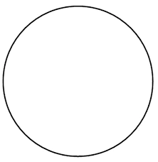





Exercise If ‘O’ is the centre of circle OD = 3.5 find BC
$$B$$
$$O$$
$$A$$
$$D$$
$$C$$

Slide 38
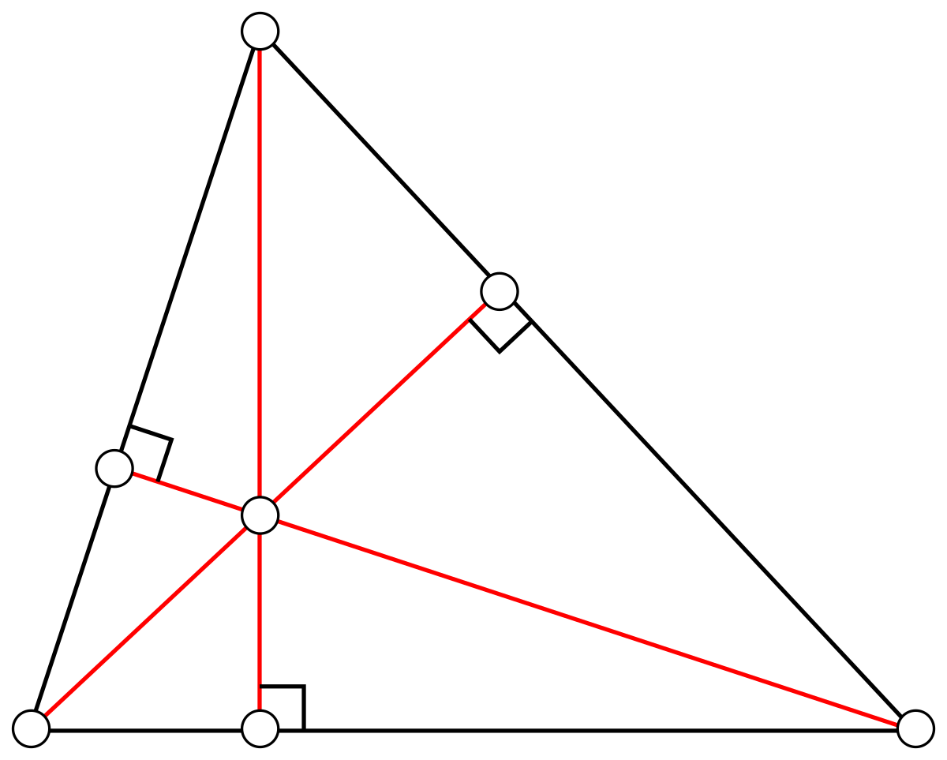
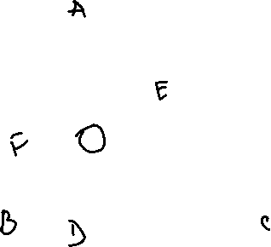
Triangles
Two lines --------------- at a point.
Three or more lines ------------- at a point.
Points of ------------------------
1.ALTITUDES
The point of ------------------ of the altitudes
of a triangle is the ----------------
AD,BE and CF are the altitudes.
O is the ------------------------------

Slide 39
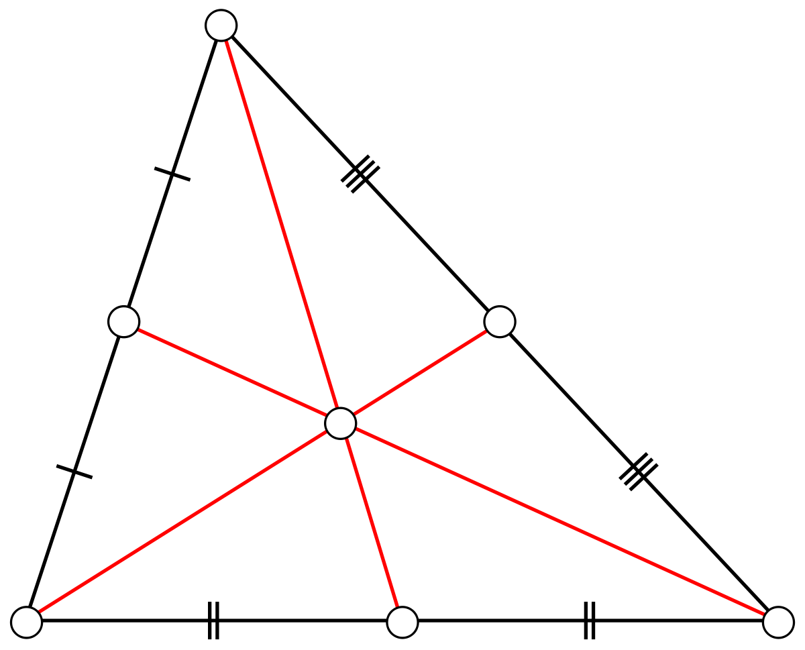
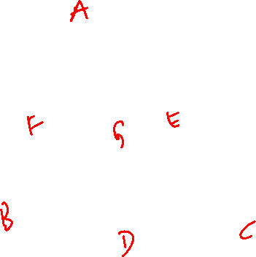
Triangles
2. MEDIANS
AD, BE and CF are the medians of triangle ABC.
Their point of concurrency G is the CENTROID
The centroid divides a median in the ratio of
2 : 1

Slide 40
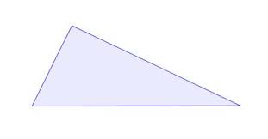




Property of a median AD is the median → BD = DC = ½ BC Area of triangle ABD = ½ x BD x AE = ½ x DC x AE = Area of triangle ADC A median divides a triangle into two triangles of equal area.
$$A$$
B
$$E$$
$$D$$
$$C$$

Slide 41
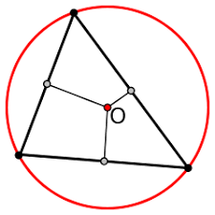

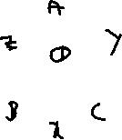
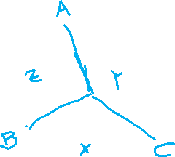
Triangles
Perpendicular bisectors of the sides:
OX, OY and OZ are the perpendicular bisectors of the sides BC,CA and AB of triangle ABC.
Their point of concurrency ‘O’ is the CIRCUM CENTRE.
The circumcentre
------→ of an acute angled triangle lies INSIDE the triangle
-----→ of an obtuse angled triangle lies OUTSIDE the triangle
----→ of a right angled triangle it is the mid point of the
Hypotenuse
The CIRCUMCENTRE is equidistant from the vertices of the
triangle
OA = OB = OC circum radius

Slide 42
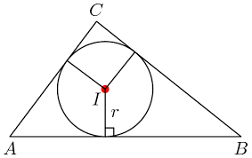
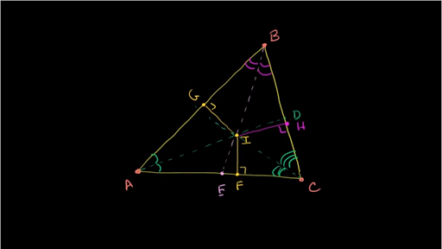
Triangles
Angle bisectors:
AD,BE and CG are the angle bisectors of <A, <B and <C
Their point of concurrency ‘I’ is the INCENTRE
IF is the INRADIUS

Slide 43
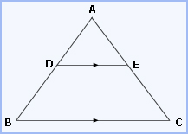


Theorems
Basic proportionality Theorem ( BPT )
The line drawn parallel to any one side of a
Triangle divides the other two sides in
Proportion.
Given DE ‼ BC
Then AD/BD = AE/EC

Slide 44

Triangles
Mid Point Theorem 1.
The line drawn through the mid point of one side of a triangle
parallel to the another side bisects the third side.
-→ D is the mid point of AB
DE is drawn parallel to BC
Then AE = EC

Slide 45

Triangles
Mid point theorem 2
The line joining the mid points of any two sides of a triangle will be parallel to the third side and half of it.
D and E are mid points of AB and AC
Then DE ‼ BC and DE = ½ BC

Slide 46
TRIANGLES
If the largest angle in a triangle is 70º, what is least possible value of the smallest angle of the triangle?

Slide 47

exercise
If
D find length AB if length BC = 25
α
35
B 50 C
25
$$A$$
α = 95 and AD:DC = 4:5

Slide 48

Quadrilaterals : Squares
1. All sides are equal
2. All angles are equal
3. Diagonals are equal
4. A Diagonal divides a square into 2 congruent triangles
5. Both the diagonals divide the square into 4 congruent triangles

Slide 49

Rectangles
1. Opposite sides are equal
2. All angles are equal
3. Diagonal are equal
4. A Diagonal divides the rectangle into 2 congruent triangle
5. Both the diagonals divide the rectangle into 2 pairs of congruent triangles.

Slide 50

Rhombus

Slide 51

Rhombus : Properties
1. All sides are equal
2. One pair of opposite angles are acute and equal and the other pair obtuse and equal
3. Diagonals are not equal
4. Diagonals bisect each other Perpendicularly
5. A diagonal divides the rhombus in to 2 congruent triangles
6. Both the diagonals divide the rhombus into 4 right
Angled congruent triangles
7. If one angle of a rhombus is 60⁰ then the
longer diagonal = $\sqrt{3}$ ( shorter diagonal)

Slide 53

Trapezium
Only one pair of opposite sides are parallel
If the non – parallel sides are equal then it is an isosceles trapezium
In an isosceles Trapezium the diagonals are equal

Slide 54

parallelogram
Opposite sides are parallel and equal
Opposite angles are equal
Adjacent angles are supplementary
Diagonals are not equal
Diagonals bisect each other
A diagonal divides the parallelogram into 2 congruent triangles
Both the diagonals divide the parallelogram in to 2 pairs of congruent triangles

Slide 55



Polygons
A many sided closed figure
Convex Polygon: A polygon in which each angle is <180
Concave Polygon : A polygon in which at least one angled is reflex
180 < x < 360
.Regular Polygon: A Polygon in which each side and each angle is equal

Slide 56


Properties of polygon
Number of sides | Name of the polygon | Sum of interior angles (2n – 4) 90 | each interior angle x | Each exterior angle y | Number of diagonals $$\frac{n(n−3)}{2}$$
3 4 5 6 7 8 9 10 | Equilateral Triangle Square Pentagon Hexagon Heptagon Octagon Nonagon Decagon | 180 360 540 720 900 1080 1260 1440 | 60 90 108 120 128$\frac{4}{7}$ 135 140 144 | 120 90 72 60 51$\frac{3}{7}$ 45 40 36 | 0 2 5 9 14 20 27 35

Slide 57

Properties of polygon
Points to remember:
The sum of interior angles = (2n -4)90⁰
The sum of exterior angles = 360⁰ (always)
The interior and exterior angles are supplementary
➔ x + y = 180⁰
The number of sides = $\frac{360}{y}$
Also n of sides = 2[α +1], α = $\frac{x}{y}$
Number of diagonals = nC₂ – n = $\frac{n\left(n−3\right)}{2}$

Slide 58
Polygons : Exercise
If the sum of interior angles is equal to 4 times the sum of exterior angles find the n of sides of the polygon
If each interior angle is equal to 11 times each exterior angle find the number of sides of the polygon

Slide 59
exercise
If the difference between each interior angle of two polygons of sides n and (n + 1) is 12. Find ‘n’
If the measure of each interior angle of a regular polygon is numerically equal to 20 times its side, find the number of sides. Select all that apply.
A) 3 B) 4 C) 5 D) 6 E) 8

Slide 60






Circles
Locus: The path traced by a moving point
Definition: The locus of the point such that it is at a constant distance from a fixed point is a circle
The fixed point is the centre of the circle
The constant distance OP = r , is a radius
AB = 2r , a diameter
CD is a chord
An arc
$$r$$

Slide 61




Circle:
Sector:
$$r$$
l = length of arc of a sector
l = $\frac{θ}{360}2πr$
a = Area of a sector
a= $\frac{θ}{360}πr^{2}$
Also area = ½ lr
$$l$$

Slide 62

Properties of circles
chord properties
1. Equal chords are equidistant from the centre
If AB = CD then OP = OQ
2.Chords which are equidistant from the centre will be of equal lengths
If OP = OQ then AB = CD

Slide 63

Chord Properties
3.The line drawn from the centre perpendicular to a chord bisects the chord
4.The line joining the centre and the midpoint of a chord will be perpendicular to the chord
If AP = BP then OP perpendicular AB
If OP perpendicular AB then AP = BP

Slide 64









Chord properties
5.Longer chords are nearer the centre
If om = 3.8 cm and on = 3.7 cm
Column A Column B
PQ CD
$$P$$
$$m$$
$$Q$$
A
$$o$$
$$B$$
$$C$$
$$n$$
$$D$$

Slide 65


Chord Properties
6.Equal chords subtend equals/arcs/ Segments / angles

Slide 66





Chord Properties
7.AB and CD are two chords intersecting internally at E, then AE x BE = CE x DE
$$x$$
$$6$$
$$12$$
$$8$$

Slide 67

Chord properties
8.AB and CD are two chords extended to meet at O, outside the circle. Then AO x BO = CO x DO

Slide 68




Chord properties
9. QR is a chord and PS is a tangent then, PQ x PR = PS²
$$27$$
$$9$$
$$x$$
PQ.PR =
PS²

Slide 69


Angle Properties
The angle in the centre is twice the angle in the remaining part of the circle
<AOB = 2<ACB
2. Angles in the same segment are equal
<AC ₁B =<AC₂B = <AC₃B = $\frac{1}{2}<AOB$ = x

Slide 70


Angle properties
3) Angles in the equal segments are equal
4) The angle in the semi circle Is a right angle
If AC is a diameter then <AOC = 180
<ABC = 90
$$O$$

Slide 71

Tangent properties
Two tangents of equal lengths can be drawn from an external point to a circle
CD = CB

Slide 72


Note:
Whenever a circle is inscribed in a figure
( triangle, quadrilateral etc.)
The out side figure vanishes because they are equal tangents from the vertices.

Slide 73


Tangent properties
The tangent is perpendicular to a radius at the point of contact
<OTP = 90
$$P$$

Slide 74



Cyclic Quadrilaterals
1. The opposite angles of a cyclic quadrilateral are supplementary
< 1+ <2 = 360
<A + <C = $\frac{<1}{2}+\frac{<2}{2}=180$
2. The exterior angle of acyclic is equal to the remote interior angle
a + c= 180 (from 1)
c + e = 180 (straight line)
<e = <a

Slide 75

exercise
Let ABCD be a cyclic quadrilateral. Suppose that ∠DBC=55 and ∠BAC=45.
What is the value of ∠BCD?
Solution: Consider the following figure:
We have:
∠1=∠DBC=55 (angles in the same segment)
è ∠BAD=45+55=100 Now,
∠BCD=180−∠BAD (why?)
è ∠BCD=180−100=80

Slide 76

exercise
Find the value of x in the given figure.
In triangle ACB,
<ACB = 90 (Angle in a semicircle)
Sum of opposite angles in a quadrilateral = 180
<ADC + <ABC = 180
120 + <ABC = 180
<ABC = 60
<ACB + <CAB + <ABC = 180
x + 90 + 60 = 180
x + 150 = 180
x = 180 - 150
x = 30

Slide 77

exercise
Find ‘x’ and ‘y’ in the given cyclic quadrilateral ABCD.

Slide 78




Mensuration 2D
A = $\frac{1}{2}×base ×height$
$A=\frac{1}{2}×BC ×AD$
$Area=\frac{1}{2}×Corresponding base ×Corresponding height$
$$Area= \sqrt{s\left(s−a\right)\left(s−b\right)\left(s−c\right)}$$
$$S=semi perimeter = \frac{ a+b+c}{2}$$

Slide 79

Mensuration 2D : Triangles
Find area :
1. a = 5 , b = 6 , c= 7
Solution:
$s= \frac{5+6+7}{2}=9$
$A= \sqrt{9\left( 9−5\right)\left( 9−6\right)\left( 9−7\right)}$
$= \sqrt{9 ×4 ×3 ×2 }=6\sqrt{6}$ square units

Slide 80
Mensuration 2D : Triangles
Pythagorean Triplets :
a² + b² = c²
1) 3 , 4, 5 2) 5, 12, 13 3) 7, 24, 25 4) 8, 15, 17 5) 9, 40, 41
6) 11, 60, 61 7) 12, 35, 37 8) 13, 84, 85 9) 16, 63, 65
10) 20, 21,29

Slide 81




Mensuration 2D : Triangles
Isosceles Triangle:
Equilateral Triangle:
$Area=\frac{1}{2}×a × \frac{\sqrt{3}}{2}a= \frac{\sqrt{3}}{4} a^{2}$
Also $Area= \frac{h^{2}}{\sqrt{3}}$
$$Area=\frac{b}{4}\sqrt{{4a}^{2}− b^{2}}$$
a = equal side
b = base

Slide 82




Quadrilaterals
Name of figure fig Area Perimeter Diagonal
Square a² 4a $\sqrt{2} a$
Rectangle lb 2(l + b) $\sqrt{l^{2}+ b^{2}}$
Parallelogram A= b x h
also in a parallelogram ${{ d}_{1}}^{2}+ {d_{2}}^{2}=2(a^{2}+ b^{2})$
where ${ d}_{1}$ and${ d}_{2}$ are the diagonals and ‘a’ and ‘b’ are the adjacent sides

Slide 83





Quadrilaterals
Rhombus $A=\frac{1}{2} d_{1} d_{2}$
Trapezium:
Any Quadrilateral
$A=\frac{1}{2}d\left(h_{1}+ h_{2}\right)$
A $=\frac{1}{2}h(a+b)$

Slide 84



Quadrilaterals
Area of path running inside:
Area of path = $L ×w−\left(L−2W\right)\left(B−2W\right)=2W\left(L+B−2W\right)$
Area of path running Across:
Area of path = W [ L + B – W]

Slide 85



Mensuration 3D
Name of fig curved total Volume
figure surface surface
area area
Cylinder 2πrh 2πr² + 2πrh πr²h
Cone πrl πr² + πrl ¹⁄₃( πr²h )
Sphere 4πr2 4⁄₃πr³

Slide 86



Mensuration : 3D
Name of fig lateral total Volume Length of
figure surface surface longest area area diagonal
Cube 4a² 6 a² a³ $\sqrt{3}$a
Cuboid 2h(l+b) 2(lb +bh +hl) lbh √( l2 + b2 +h2)

Slide 87


Exercise 2 D
PQ // RS, <OAQ = 40⁰ and <OBS = 30⁰
Find <AOB
$$40$$
$$30$$
What the perimeter is of triangle ABC?
30 + 75 = 105
So the third angle is 180-105 = 75
The triangle is isosceles
Therefore the perimeter
= 4 + 4+ 3 = 11

Slide 88


Exercise 2D
The area of right triangle ABC is 15. What is the length of hypotenuse BC?
Area of triangle = ½ x bh = 15
= 1/2x b x 5 = 15
b = 6
so, BC = $\sqrt{5^{2}+6^{2}}$ = $\sqrt{61 } =$ 7.8

Slide 89
exercise
Isosceles triangle ABC has two sides with lengths 8 and 5
It could be triangle with sides 5,5 and 8 or 8,8 and 5
So the third side could be 5 or 8
Ans : ‘D’
Quantity A Quantity B
The length of the third side 8

Slide 90

Exercise 2D
What is the number of possible values of ‘x’?
X is an integer

Slide 91

exercise
Find ‘x’

Slide 92
examples
The perimeter of one square field is 60 m and that of another is 80 m. Find the diagonal of the third square field whose area equals the sum of the areas of the former two.
The adjacent sides of a parellelogram are 11cm and 13 cm. If one of the diagonals is 16 cm , find the other.

Slide 93

trapezium

Slide 94




Exercise Find Area of the trapezium above.
$$60$$
$$26$$
$$26$$
$$80$$

Slide 95
exercise
Find the width of the path if the path area = 570 square metres given the outer measurements are 37m (L) and 30 m (B)

Slide 96


exercise
AB is not a diameter of the circle
Quantity A Quantity B
The area of the circle 9$π$

Slide 97



Example
ABCD is a parallelogram. AE is perpendicular to DC and CF is perpendicular
to AD. If AB = 16 , AE = 8 and CF = 10, find AD.
Area of a parallelogram = b x h
AD x CF = AB x AE
AD x 10 = 16 x 8
AD = 128 / 10 = 12.8
$$F$$
$$E$$

Slide 98

Example
.
Calculate the perimeter of the parallelogram if the length of the horizontal side is 12

Slide 99

Example
Calculate the perimeter of the parallelogram.

Slide 100

Example
Rectangle PQRS has a perimeter equal to 34 units. What is x, the length of the diagonal PR?

Slide 101


Exercise 2 D
In the figure below, point O is the centre of the circle. If the radius of the circle is 8, what is the area of the shaded sector?
If the diameter of the circle is 36, what is the length
of arc ABC?
The circumference of the front wheel of a cart is 30 ft long and that of the back wheel is 36 ft long. What is the distance travelled by the cart, when the front wheel has done five more revolutions than the rear wheel?

Slide 102
Exercise 3 D
If a right circular cylinder’s radius is halved and its height doubled, by what percent will the volume increase or decrease?
A cube and a rectangular solid are equal in volume. If the length of the edges of the rectangular solid are 4, 8 and 16, what is the surface area of the cube?

Slide 103
Exercise 3 D
The radius of a right circular cylinder is 8cm and its height is 20cm. If a new cylinder is formed by increasing either the radius or the height by 25%, then find the new volume of the cylinder. Select all that apply.
A square prism of height 11 inches has a volume of 539 cubic inches.
Find the length of each side of the square base
( Note : Volume of a square prism = Area of the base x height)

Slide 104

Co-ordinate Geometry
(2, -3) is in -- Q
(-5,4) is in --- Q
(-3, -5) is in --- Q
(4, 5) is in -- Q
II Q I Q
x < 0, y > 0 x>0 , y>0
III Q IV Q
x < 0,y < 0 x > 0 , y < 0

Slide 105


















Co-ordinate Geometry
Draw the graph of x + y = 5
X | 0 | 5 | 1 | 2 | 3 | 4
Y | 5 | 0 | 4 | 3 | 2 | 1
A B C D E F
A
$$5$$
$$45$$
$$C$$
$$4$$
$$D$$
$$3$$
$$2$$
$$E$$
$$1$$
$$F$$
$$45$$
$$135$$
$$0$$
$$1$$
$$2$$
$$3$$
$$4$$
$$5$$
$$B$$

Slide 106

Co-ordinate Geometry
m = tan$θ$
Tan135 = tan(190 + 45)= -cot 45 = -1
X + y = 5 is a linear equation and
a linear equation always represents a straight line
Consider the ratio of $\frac{difference in y coordinate}{difference in x co−ordinates}$
$AB= \frac{5−0}{0−5}=\frac{5}{−5}= −1$ A( 0,5) B(5,0)
$BD= \frac{0−3}{5−2}= −\frac{3}{3}= −1$ B (5,0) D(2,3)
$DE= \frac{3−2}{2−3}=\frac{1}{−1}=−1$ D(2,3) E(3,2)
$CF= \frac{4−1}{1−4}=\frac{3}{−3}= −1$ C(1,4) F(4,1)
This constant (-1) is called the slope of the line x + y = 5 ----> Slope = $\frac{y_{2}− y_{1}}{x_{2}− x_{1} }$

Slide 107

Co-ordinate Geometry
Definition of slope:
Slope is the tangent of the angle which the line makes with the positive direction of the x – axis and it is denoted by ’ m’ & m = tan$θ$
Slope of x – axis:
Any two points on the x – axis are of the form ($a_{1}$,0) ($a_{2},0)$
Slope = $\frac{0−0}{a_{1}− a_{2}}=0$
Slope of x – axis is zero

Slide 108

Co-ordinate Geometry
Slope of y –axis:
Any two points on the y-axis are of the form (0,$b_{1})$(0, $b_{2})$
Slope = $\frac{b_{1}− b_{2} }{0}$ is indeterminant
Slope of y – axis does not exist

Slide 109

Co-ordinate Geometry
Slope of parallel lines:
Parallel lines have equal slopes

Slide 110
exercise
Suppose the equation of the first line is −3x+y=4. What must be the value of k to make
the second equation −kx=4+y parallel to the first line?

Slide 111





Co-ordinate geometry
Slopes of Perpendicular lines:
The condition for two lines with slopes m₁ and m₂ to be perpendicular = m₁ x m₂ = -1
$l_{1}$ is perpendicular to $l_{2}$
$θ_{1}$ is the exterior angle of triangle
$θ_{1}$ = 90 + $θ_{2}$
Therefore tan $θ_{1}$ = tan (90 + $θ_{2})$
= - cot $θ_{2}$
= -1/tan $θ_{2}$
→ tan $θ_{1}$ x tan $θ_{2}$ = -1
Or $m_{1}$ x $m_{2}$ = -1
The product of the slopes = -1
$$l_{1}$$
$$l_{2}$$
$$θ_{1}$$
$$θ_{2}$$

Slide 112

Co-ordinate geometry
slope of any line :
ax + by + c = 0
by = -ax – c
$$y= −\frac{a}{b}x−\frac{c}{b}$$
$$m= −\frac{a}{b}$$
$$slope=− \frac{coeffiecient of x}{coeffecient of y}$$

Slide 113

Co-ordinate Geometry
Miscellaneous:
The distance between any two points (x₁, y₁) and (x₂, y₂) is
d = $\sqrt{{(y_{2}− y_{1})}^{2}+{(x_{2}− x_{1})}^{2} }$
Find the distance b/w the two points (-3,2) and (2,4)

Slide 114


Co-ordinate geometry
The co-ordinate of the mid point joining (x₁, y₁) and (x₂, y₂) is
= $\left\{\frac{x_{1}+ x_{2}}{2}, \frac{y_{1}+ y_{2}}{2}\right\}$
A(x,y) O B(2,-3)
If ‘O’ is the centre (0,0)
Find (x,y)
$$O$$

Slide 115

Co-ordinate geometry
The co-ordinates of the point p(x ,y) dividing the line joining (x₁, y₁) and (x₂, y₂) internally in the ratio of m : n
=$\left\{\frac{m x_{2} +nx_{1}}{m+n} , \frac{m y_{2} +ny\text{1}}{m +n}\right\}$

Slide 116

exercise
Find the coordinates of the points of trisection (i.e., points dividing into three equal parts) of the line segment joining the points A(2, – 2) and B(– 7, 4).
Solution:
Let P and Q be the points of trisection of AB, i.e., AP = PQ = QB.
Therefore, P divides AB internally in the ratio 1: 2.
Let (x₁, y₁) = (2, -2)
(x₂, y₂) = (-7, 4)
m₁ : m₂ = 1 : 2
Therefore, the coordinates of P, by applying the section formula,
(m1x2+m2x1m1+m2,m1y2+m2y1m1+m2) =⌊1(−7)+2(2)1+2,1(4)+2(−2)1+2⌋
= (-3/3, 0/3)
= (-1, 0)
Similarly, Q also divides AB internally in the ratio 2 : 1. and the coordinates of Q by applying the section formula,
=⌊2(−7)+1(2)2+1,2(4)+1(−2)2+1⌋
= (-12/3, 6/3)
= (-4, 2)
Hence, the coordinates of the points of trisection of the line segment joining A and B are (–1, 0) and (– 4, 2).

Slide 117

Co-ordinate geometry
The co-ordinates of the centroid of triangle ABC A(x₁, y₁) B (x₂, y₂) C($x_{3}, y_{3})$
G(x, y) = $\frac{ x_{1} +x_{2}+ x_{3}}{3} ,\frac{ y_{1} +y_{2}+ y_{3}}{3}$

Slide 118








Co-ordinate Geometry
Equations of lines:
Equation of the line through the origin is y = mx
Slope = tan
m = opp/adj = y/x
=> y = mx
$$P(x,y)$$
$$y$$
$$O$$
$$(0,0)$$
$$x$$
$$Q$$

Slide 119

Co-ordinate geometry
Equation of the line whose slope is ‘m’ and y intercept ‘c’ is
y = mx + c

Slide 120

Co-ordinate geometry
Equation of the line whose slope is ‘m’ and through
any point (x₁ , y₁) is : ( $y− y_{1}$) = m (x- x₁ )

Slide 121

Co-ordinate geometry
Equation of the line through any two points ( x₁, y₁) and (x₂, y₂) is
$y− y_{1}= \frac{y_{2}− y_{1}}{x_{2}− x_{1}}$( x – x₁)

Slide 122

Co-ordinate geometry
Equation of the line in the intercepts form is $\frac{x}{a}+\frac{y}{b}=1$

Slide 123

Co-ordinate geometry
The area of triangle ABC A(x₁, y₁) B (x₂, y₂) C($x_{3}, y_{3})$ is
A = $\frac{1}{2}\left|x_{1}\left( y_{2}− y_{3}\right)+ x_{2}\left( y_{3}− y_{1}\right)+ x_{3}( y_{1}− y_{2)}\right|$
Find the value of k if the points A(2, 3), B(4, k) and C(6, –3) are collinear
Given,
A(2, 3)= (x₁, y₁) B(4, k) = (x₂, y₂ C(6, -3) = (x₃, y₃)
If the given points are collinear, the area of the triangle will be 0.
½ [x₁(y₂ – y₃) + x₂(y₃ – y₁) + x₃(y₁ – y₂)] = 0
½ [2(k + 3) + 4(-3 -3) + 6(3 – k)] = 0
½ [2k + 6 – 24 + 18 – 6k] = 0
½ (-4k) = 0
4k = 0
k = 0

Slide 124
Co-ordinate geometry: Exercise
Find the area of the triangle formed by the vertices (4, 5), (10, 12) and (-3, 2)

Slide 125
exercise
Find a relation between x and y such that the point P(x, y) is equidistant from the points A (2, 5) and B (-3, 7)
Let P (x, y) be equidistant from the points A (2, 5) and B (-3, 7).
∴ AP = BP …[Given AP² = BP² …[Squaring both sides
(x – 2)² + (y – 5)² = (x + 3)² + (y – 7)² ⇒ x² – 4x + 4 + y² – 10y + 25 ⇒ x² + 6x + 9 + y² – 14y + 49 ⇒ -4x – 10y – 6x + 14y = 9 +49 – 4 – 25 ⇒ -10x + 4y = 29 ∴ 10x + 29 = 4y is the required relation

Slide 126

Vertex of a parabola
The vertex of a parabola is the point where the parabola crosses
its axis of symmetry.
If the coefficient of the x2 term is positive, the vertex will be the lowest point
on the graph, the point at the bottom of the “ U ”-shape.
If the coefficient of the x2 term is negative, the vertex will be the highest point
on the graph, the point at the top of the “ ∩ ‘shape.

Slide 127
Vertex of the parabola
The standard equation of a parabola is
y=ax2+bx+c
.But the equation for a parabola can also be written in "vertex form":
y=a(x−h)2+k
In this equation, the vertex of the parabola is the point (h,k)
y=ax2−2ahx+ah2+k
. This means that in the standard form, y=ax2+bx+c
, the expression −b/2a gives the x -coordinate of the vertex.
Substituting ‘x’ value in the equation we can get the value of ‘y’

Slide 128


exercise
Find the vertex of the parabola :
Y = $x^{2}$ -2x + 3
Here a = 1 b = -2
x = -b/2a = -(-2)/2(1) 2/2 = 1
-→ y = ($1^{2}$) – 2(1) + 3 = 1-2 + 3 = 2
The vertex is ( 1,2)
Or , writing in the perfect square form and remainder
y =( x-1) + 2 ➔ h = 1 and k= 2
$$2$$

Slide 129
Exercise
.
Find the vertex of the parabola.
y=3x2+12x−12
Here, a=3 and b=12 . So, the x
-coordinate of the vertex is:
−12/2(3)=−2
Substituting in the original equation to get the y
-coordinate, we get:
y=3(−2)2+12(−2)−12 =−24
So, the vertex of the parabola is at (−2,−24)

Slide 130
exercise
Find the vertex of the parabola y=x2+4x−9

Slide 131
Co-ordinate geometry
Find the equation of straight line passing through (2, 3) and perpendicular to the line 3x + 2y + 4 = 0

Slide 132
Co-ordinate geometry
What is one possible equation for a line parallel to the one passing through the points (4,2) and (15,-4)?

Slide 133
Exercise
Find the equation of the line passing through (2, -1) and parallel to the line
2x – y = 4.
A. y = 2x – 5
B. Y=2x+6
C. Y=√2x +7
D. 4.y=2x+5

Slide 134
Exercise
If the coordinates of one end of a diameter of a circle are (2, 3) and the coordinates of its centre are (-2, 5), then what are the coordinates of the other end of the diameter?

Slide 135
Exercise
If the points A(x, 2), B (-3,-4) and C (7, -5) are collinear, then what is the value of x?

Slide 136
Exercise
If the point A (0, 2) is equidistant from the points B(3, p) and C(p, 5), find P. Also find the length of AB.

Slide 137
Exercise
The mid-point of segment AB is the point P (0, 4). If the Coordinates of B are (-2, 3) then find the coordinates of A

Slide 138
Exercise
If two vertices of an equilateral triangle are (3, 0) and (6, 0), find the third vertex

Slide 139

exercise
In which quadrant the point P that divides the line segment joining the points A(2, -5) and B(5,2) in the ratio 2 : 3 lies?

Slide 140


exercise
Find the ratio in which y-axis divides the line segment joining the points A(5, -6), and B(-1, -4). Also find the coordinates of the point of division
Let AC: CB = m : n = k : 1.

Slide 141


exercise
Let P and Q be the points of trisection of the line segment joining the points A (2, -2) and B (-7, 4) such that P is nearer to A. Find the coordinates of P.
AP : PB = 1 : 2 Coordinates of P are:

Slide 142


exercise
A line intersects the y-axis and x-axis at the points P and Q respectively.
If (2, -5) is the mid point of PQ, then find the coordinates of P and Q
We know that at y-axis coordinates of points are (0, y) and at x-axis (x, 0). Let P(0, b) and Q(a,0) Mid point of PQ = (2, -5) …[Given

Slide 143

exercise
Find the value of k, if the point P(2, 4) is equidistant from the points A(5, k) and B(k, 7). Solution: Let P(2, 4), A(5, k) and B(k, 7).
PA = PB …[Given PA² = PB² … [Squaring both sides (5 – 2)² + (k – 4)² = (k – 2)² + (7 – 4)² 9 + (k – 4)² – (k – 2)² = 9 (k – 4 + k – 2) (k – 4 – k + 2) = 0 (2k – 60 2k = 6 ∴ k = 6/2 = 3

